Slide 1

Sapthagiri College of Engineering, Bangalore Department of Computer Science and Engineering Academic Year – 2024-25
PRESENTATION ON
NATIONAL SERVICE SCHEME
(21NS83)
Presented By:
Abhay Surya I [1SG21CS001]
Adarsh M[1SG21CS002]
Aishwarya[1SG21CS004]
Aishwarya L[1SG21CS005]
Ashiq Kumar H[1SG21CS010]
Bharathi GP[1SG21CS013]
Guided by,
Shwetha A B
Assistant Professor
Dept of CSE

Slide 2
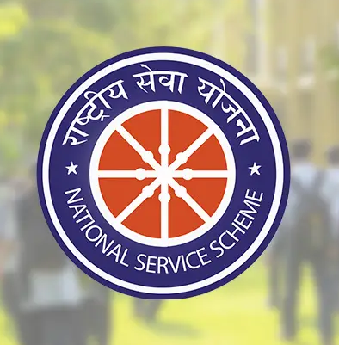
Introduction
NSS – National Service Scheme
The National Service Scheme (NSS) is a public service program started by the Indian government on 24th September 1969 to encourage students to serve society, run by the Ministry of Youth Affairs and Sports.
The main goal of NSS is to develop students’ personality by doing social work.
Motto of NSS is "Not Me, But You", which reflects the spirit of selfless service and social responsibility.

Slide 3

Role of NSS in Solving Community Problems:
Promotes social responsibility among students through active community service.
NSS bridges the gap between education and real-life societal needs.
Raises awareness on important topics like health, cleanliness, and education.
Encourages unity and teamwork by involving youth in group activities.
Promotes environmental awareness through tree plantation, clean-up drives, and conservation activities
Develops leadership skills and a sense of responsibility among youth.
Supports rural development through camps and awareness programs.

Slide 4
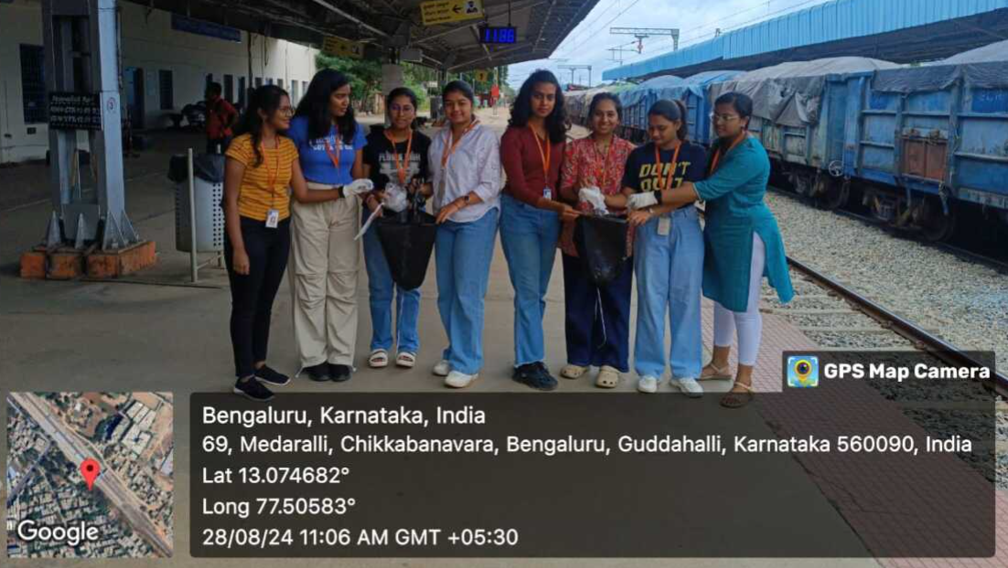
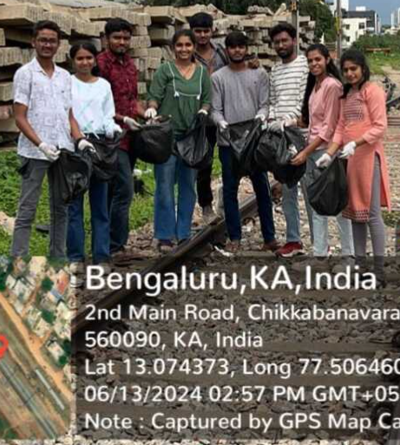
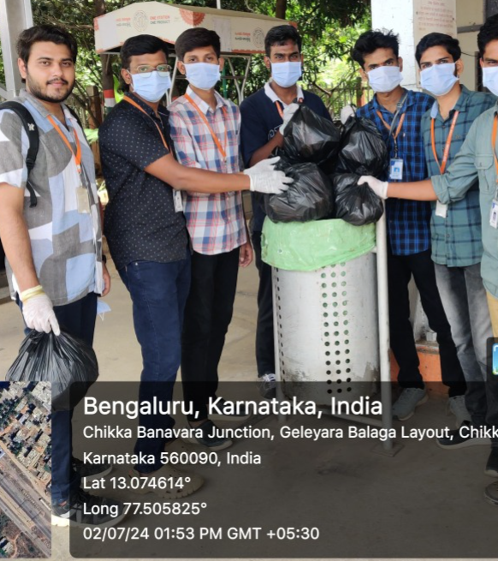
Waste Management
Waste management refers to the collection, segregation, recycling, and disposal of waste in a responsible manner to reduce pollution and protect the environment.
NSS volunteers organized an awareness and cleanliness initiative at Chikkabanavara Railway Station to promote hygiene, and support the Swachh Bharat Abhiyan through better waste segregation.

Slide 5
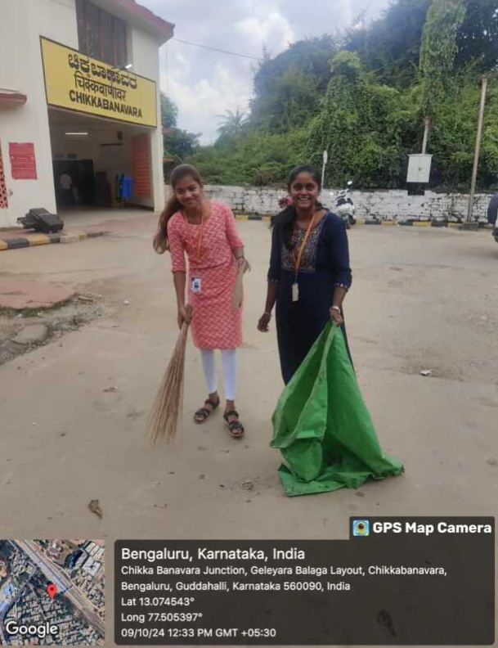
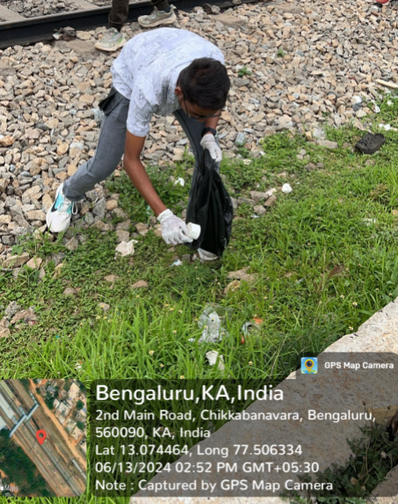
Key Actions by Volunteers:
Platforms, waiting areas, and nearby tracks were thoroughly cleaned.
Separate dustbins for dry and wet waste were strategically placed throughout the station.
Collaboration was done with railway staff to ensure cleanliness is maintained long-term.
Implement recycling programs to manage waste more effectively and promote environmental sustainability.
Establish dedicated maintenance teams responsible for different areas of the station to ensure thorough and regular cleaning.

Slide 6
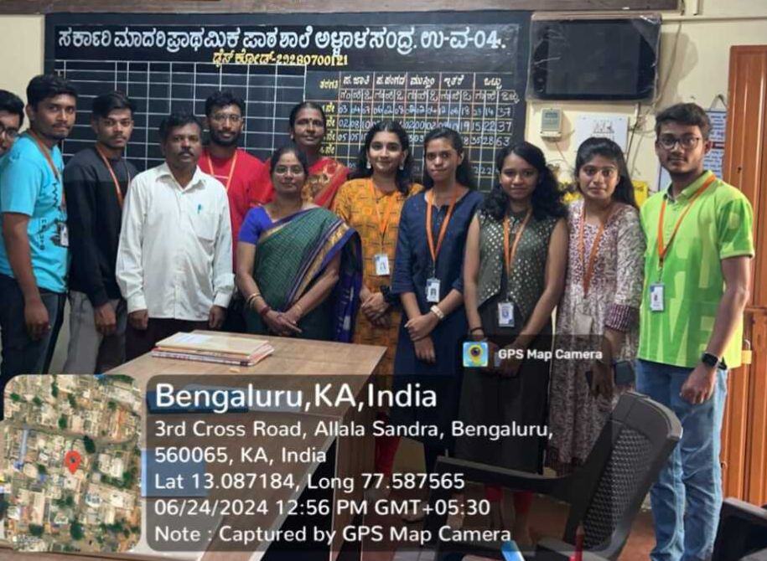
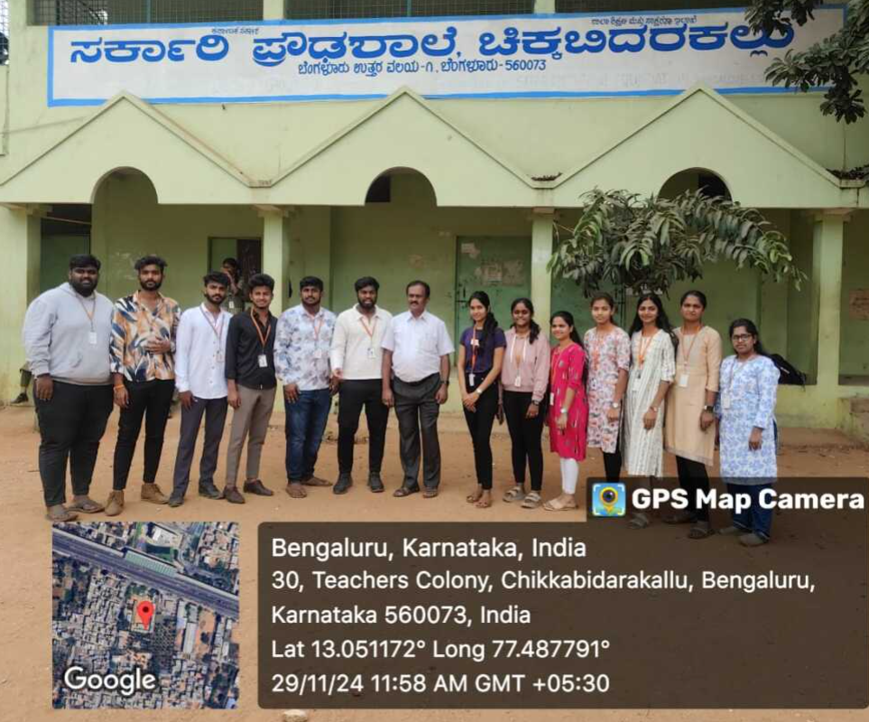
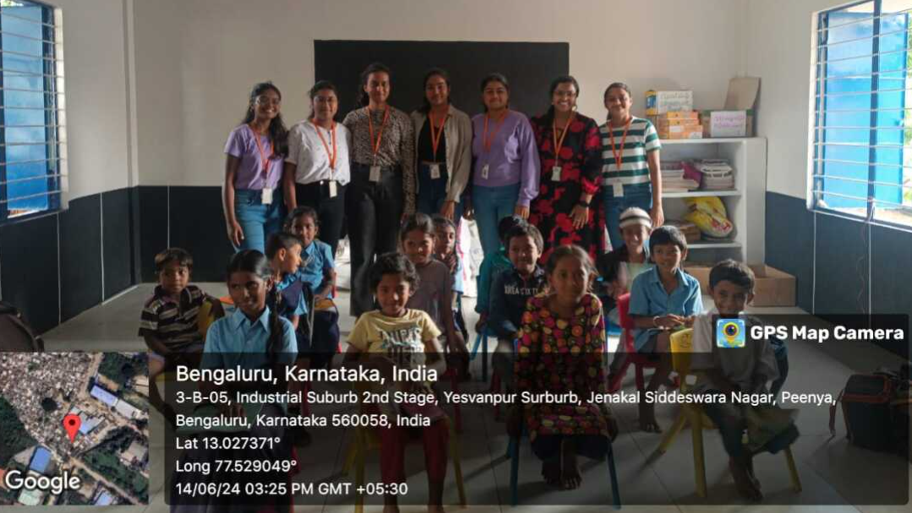
Awareness Program in Rural School
NSS volunteers conducted an educational and awareness session at the Government Primary School in Bangalore to promote hygiene and literacy among children.
We thoughtfully chose simple and interesting topics to engage the 1st and 2nd grade students during our visit.
During the session, we encouraged the children to share their thoughts and participate actively
The main goal was to help each child understand the subject in a fun and easy way.

Slide 7
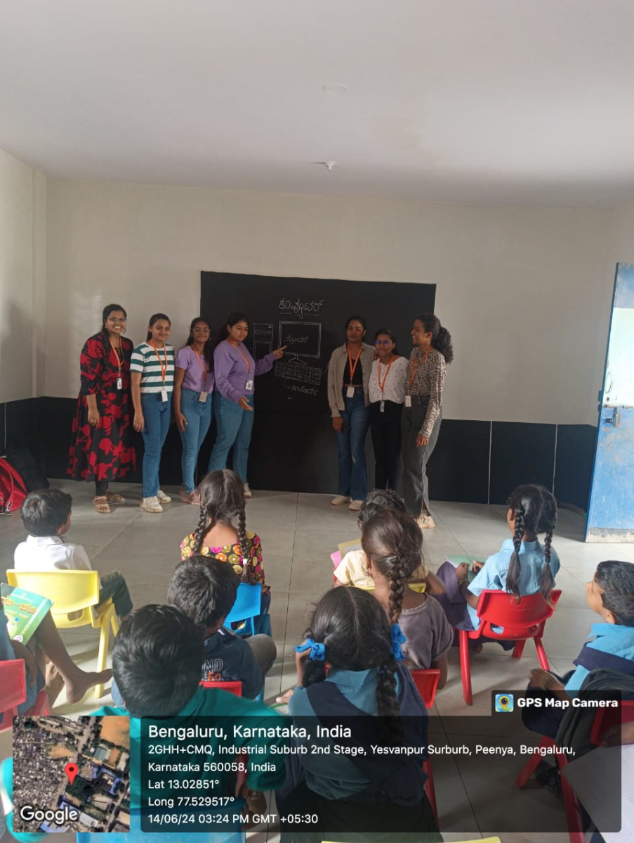
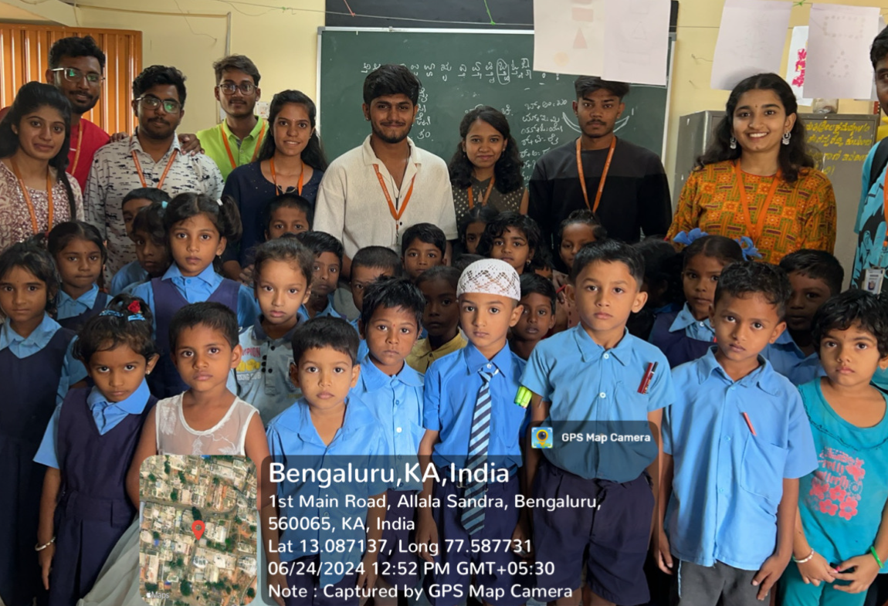
Highlights of the Activity
Taught basic hygiene practices like handwashing to promote health awareness, using interactive games and rewards to encourage active participation.
Kannada alphabets and basic computer parts were taught to help early learners build reading skills and digital literacy from a young age.

Slide 8
THANK YOU!

